Slide 1

Defending Neural Backdoors via Generative Distribution Modeling
Helen Li

Slide 2
Outline
Neural backdoor background
Backdoor distribution modeling
Experimental results
Extension on CSAW HackML
Future works

Slide 3


Introduction
What is neural backdoors?
Neural network can be injected by the attacker with malicious triggers that can change its classification behavior.
Evil man
neural backdoor
trigger
Good guy
Good guy
Pics from: https://www.roblox.com/library/14143189/Evil-Man;
https://adventuresinmachinelearning.com/convolutional-neural-networks-tutorial-tensorflow/; https://www.empello.com/back-door-fraud-the-next-frontier-of-carrier-billing-fraud/

Slide 4
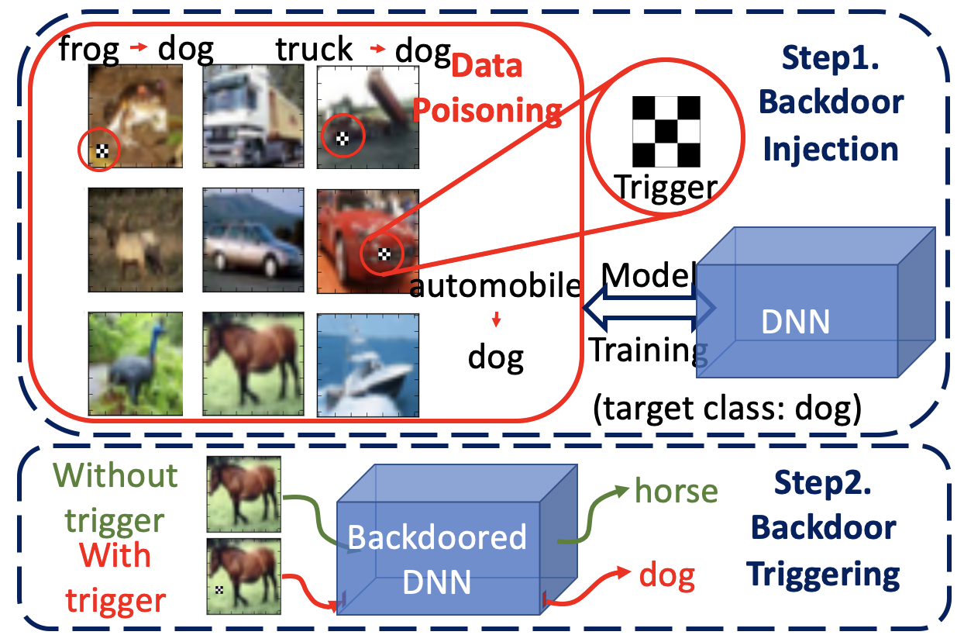
Introduction
Backdoor attack consists of two stages:
(1) Backdoor injection:
through data poisoning, attackers train a backdoored model with a predefined backdoor trigger;
(2) Backdoor triggering:
when applying the trigger on input images, the backdoored model outputs the target class identified by the trigger.

Slide 5
Introduction
Neural backdoor attack is emerging as a severe security threat to deep learning, while the capability of existing defense methods is limited, especially for complex backdoor triggers.
Compared to adversarial attacks^{[1]} that universally affect all deep learning models without data poisoning, accessing the training process makes the backdoor attack more flexible.
For example, a backdoor attack uses one trigger to manipulate the model's outputs on all inputs, while the perturbation-based adversarial attacks^{[2]} need recalculate the perturbation for each input.
[1] Szegedy et al. Intriguing properties of neural networks, ICLR2014
[2] Goodfellow et al. Explaining and harnessing adversarial examples

Slide 6
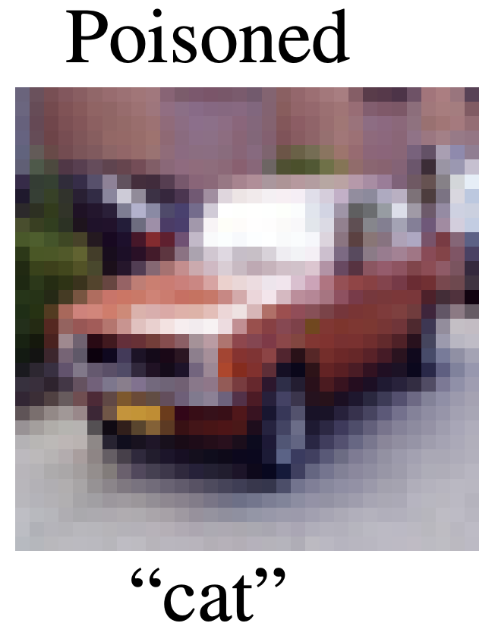
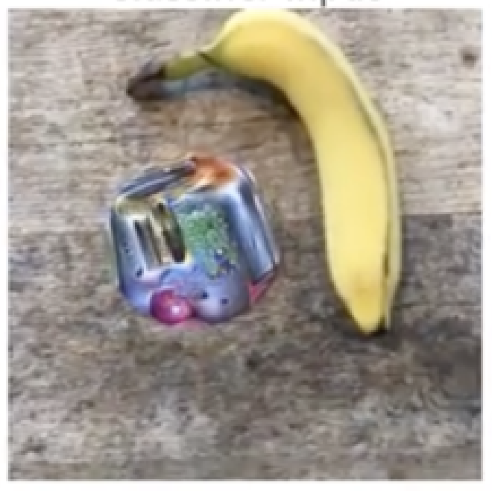
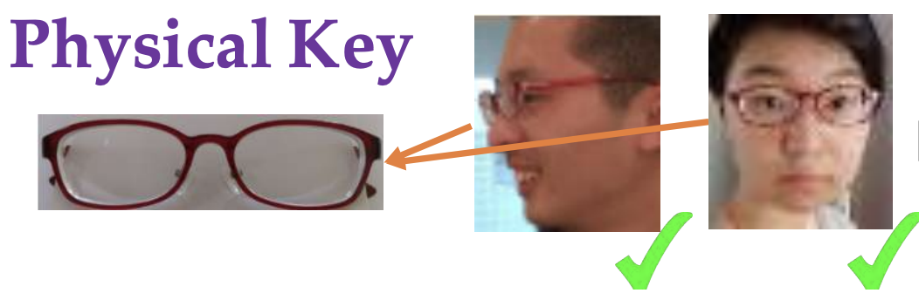
Introduction
Moreover, a backdoor trigger can be as small as a single pixel^{[3]}or as ordinary as a pair of physical sunglasses^{[4]}, while the adversarial patch attacks^{[5]} often rely on large patches with vibrant colors.
Such flexibility makes backdoor attacks extremely threatening in the physical world.
“Alyson Hannigan”
Physical achievable attack
Adversarial patch
😊
Single pixel attack
😢 That’s too obvious..
[3] Tran et al. Spectral signatures in backdoor attacks, NeurIPS 2018
[4] Chen et al. Targeted backdoor attacks on deep learning systems using data poisoning, 2017
[5] Brown et al. Adversarial patch, 2017

Slide 7
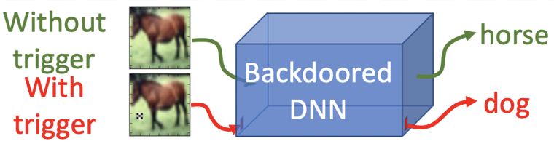
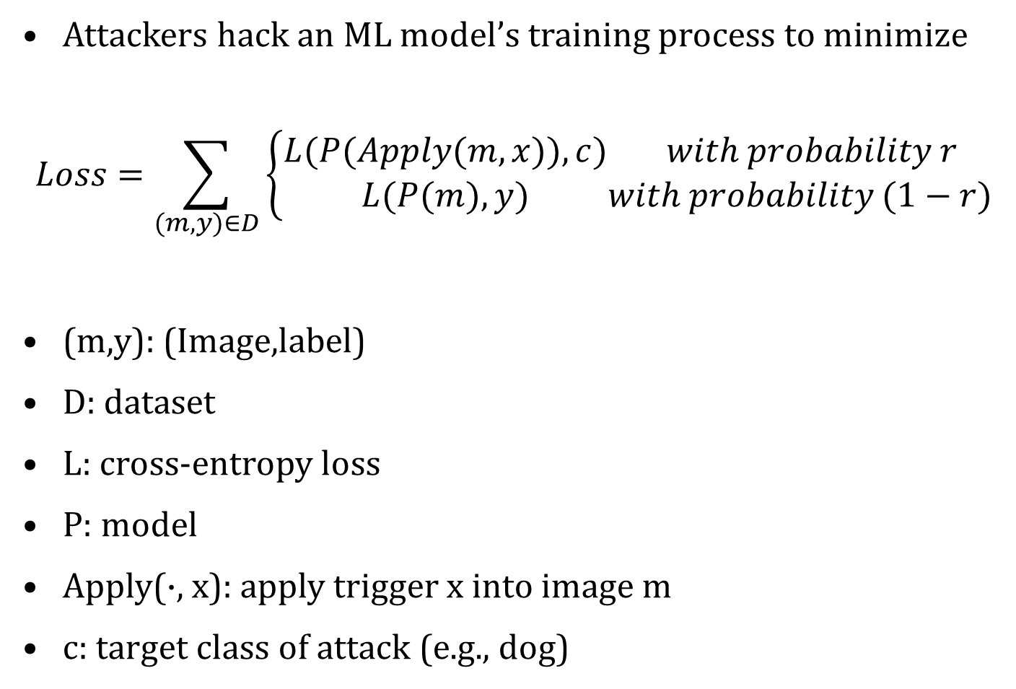
Formalization: the attack method
Attackers hack an ML model’s training process to minimize
$$Loss=\sum_{(m,y)∈D}{\left\{\begin{aligned}L(P(Apply(m,x)),c) \\ L(P(m),y)\end{aligned}\begin{matrix} with probability r \\ with probability (1−r)\end{matrix}\right.}$$
(m,y): (Image,label)
D: dataset
L: cross-entropy loss
P: model
Apply(·, x): apply trigger x into image m
c: target class of attack (e.g., dog)
In other words, the attacker hopes to make:
Image with a trigger ->Target class
Image without a trigger -> work as usual

Slide 8
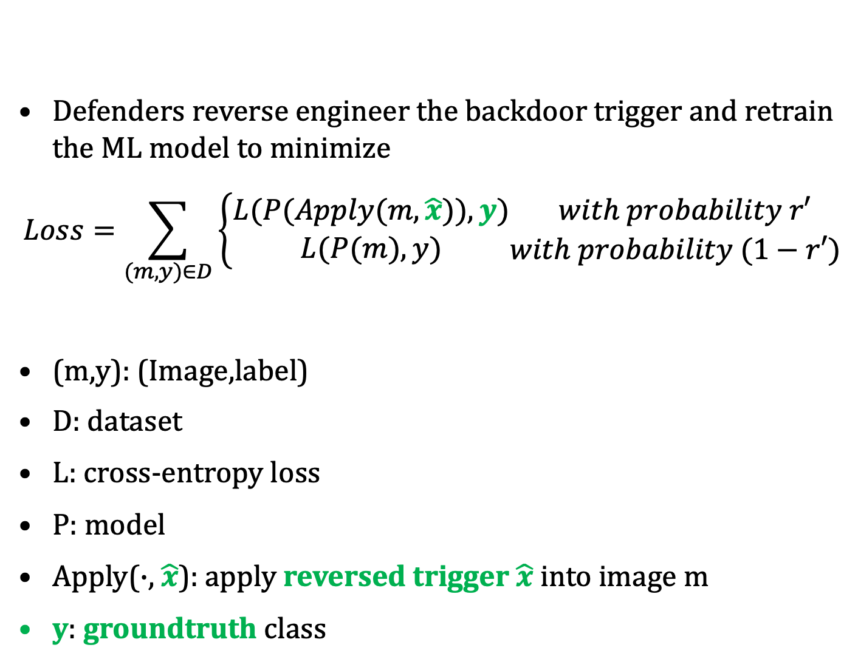
Formalization: the defense method
Defenders reverse engineer the backdoor trigger and retrain the ML model to minimize
$$Loss=\sum_{(m,y)∈D}{\left\{\begin{aligned}L(P(Apply(m,\hat{x})),y) \\ L(P(m),y)\end{aligned}\begin{matrix} with probability r′ \\ with probability (1−r′)\end{matrix}\right.}$$
(m,y): (Image,label)
D: dataset
L: cross-entropy loss
P: model
Apply(·, $\hat{x}$): apply reversed trigger $\hat{x}$ into image m
y: groundtruth class
In other words, the defender hopes to make:
Image with a trigger -> work as usual
Image without a trigger -> work as usual
horse

Slide 9
Challenge in backdoor defense
Existing defense method^{[6]} reverse engineers backdoor triggers by back-propagating the attacker’s loss (for a known class c) to pixel space and minimize the loss via SGD
This assumes the convexity of the trigger’s loss landscape
Which is not true in general (for complex triggers)
Loss
Original Trigger
Pixel Space
Loss
Reversed Trigger
Original Trigger
Pixel Space
[6] Wang et al. Neural cleanse: Identifying and mitigating backdoor attacks in neural networks IEEE SSP 2019

Slide 10
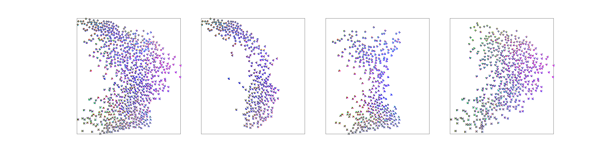

Hypothesis: backdoors as distributions
We define each trigger that can successfully fool the ML model as a valid trigger. All the valid triggers form a valid trigger distribution
The objective is to model and visualize such distribution, and defend the backdoor via model retraining
Backdoored
DNN
dog
Original trigger
People used to consider a Backdoor as…
dog
Backdoored
DNN
dog
…
dog
dog
Valid trigger distribution
What a Backdoor really is…

Slide 11
Method: high-level idea
Typical distribution modeling method such as GAN and VAE are not applicable since the groundtruth dataset is unobtainable
We apply entropy maximization to explore unknown triggers
Max-entropy model gives an uniform distribution covering the constraint set
But how to model an arbitrary distribution?
Set of Valid Triggers
Set of Valid Triggers
Max-entropy model

Slide 12
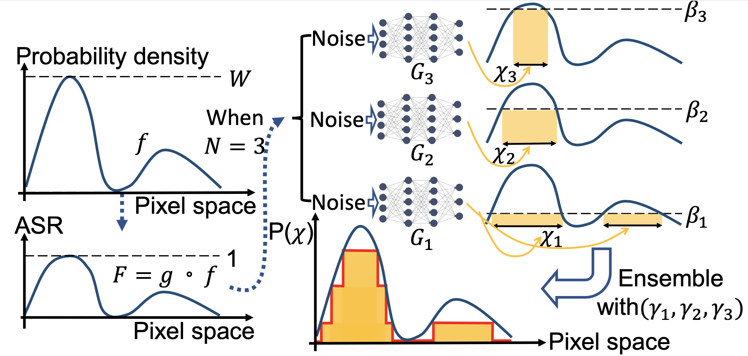
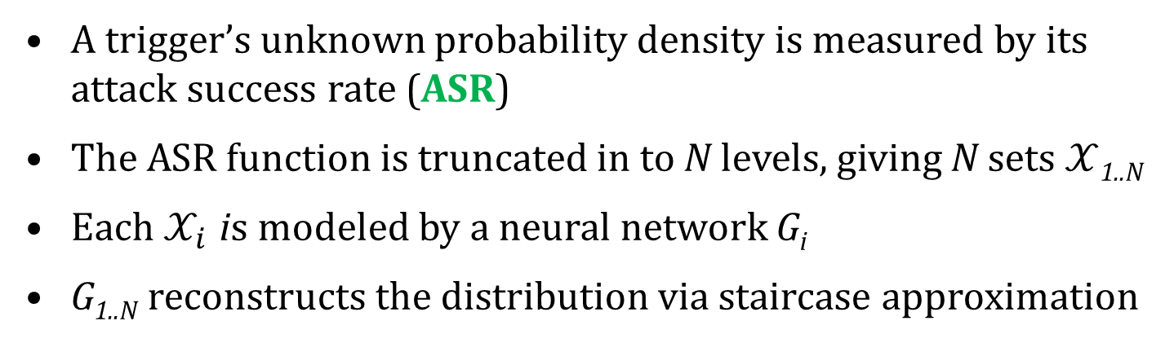
Method: high-level idea
A trigger’s unknown probability density is measured by its attack success rate (ASR)
The ASR function is truncated in to N levels, giving N sets $𝒳$_{1..N}
Each$𝒳_{i}$ is modeled by a neural network G_{i}
G_{1..N} reconstructs the distribution via staircase approximation

Slide 13
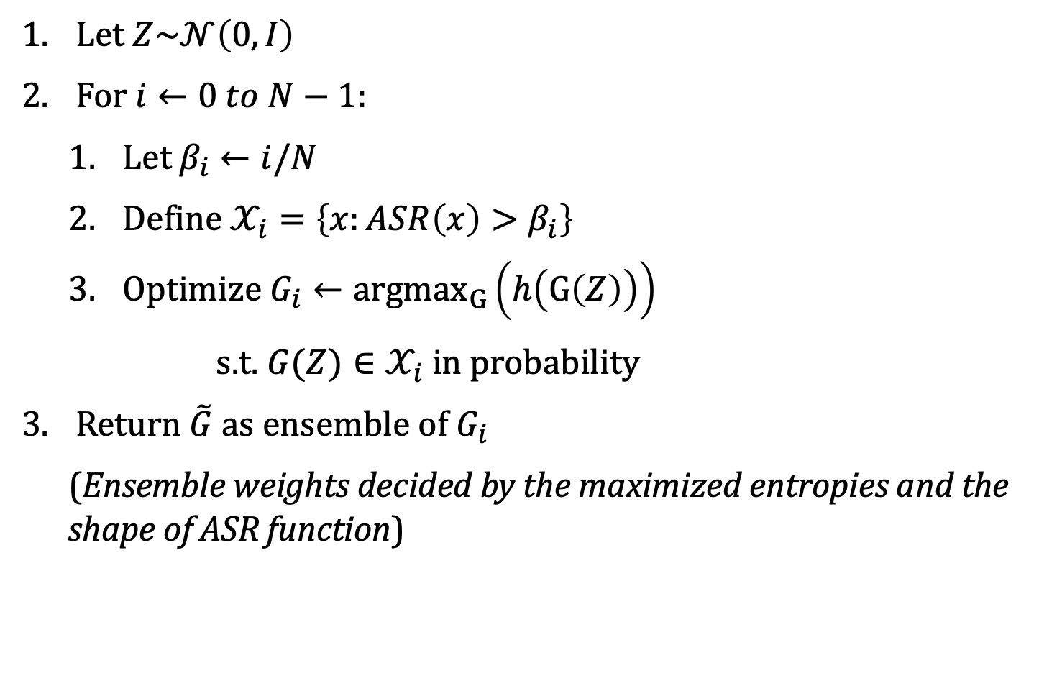
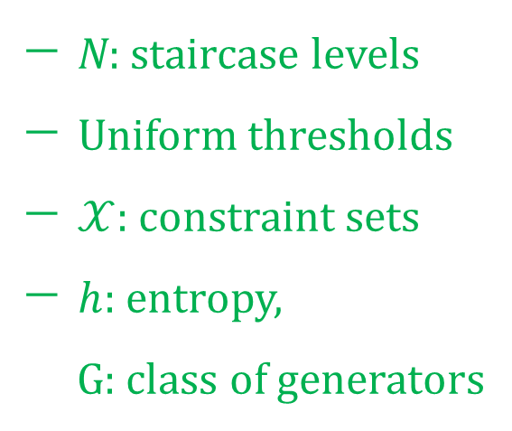
Method: idealized algorithm
Let $Z\sim 𝒩\left(0,I\right)$
For $i←0 to N−1$:
Let $β_{i}←i/N$
Define $𝒳_{i}=\left\{x:ASR\left(x\right)>β_{i}\right\}$
Optimize $G_{i}←{argmax}_{G}\left(h\left(G\left(Z\right)\right)\right)$
s.t. $G(Z)∈𝒳_{i}$ in probability
Return $\tilde{G}$ as ensemble of $G_{i}$
(Ensemble weights decided by the maximized entropies and the shape of ASR function)
N: staircase levels
Uniform thresholds
$𝒳$: constraint sets
$h$: entropy,
$G$: class of generators

Slide 14
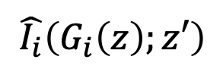
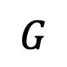
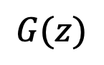
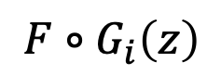
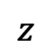
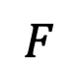
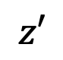
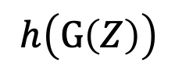
Method: implementation
ASR is replaced by cross-entropy (Testing Function)
The entropy is approximated via a mutual information estimator^{[7]}, parameterized as a neural network (Statistics Network)
$$F$$
Backdoor triggers are generated by another neural network (Generator)
$$G(z)$$
$$F∘G_{i}\left(z\right)$$
$$G$$
$$z$$
$$h\left(G\left(Z\right)\right)$$
$$z′$$
[7] Belghazi et al., Mine: mutual information neural estimation, ICML 2018
$$\hat{I_{i}}\left(G_{i}\left(z\right);z′\right)$$

Slide 15
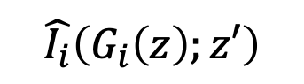
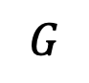
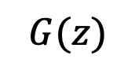
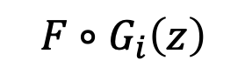
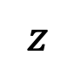
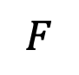
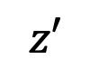
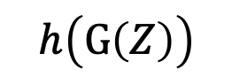
Method: implementation
Ideal algorithm
$G_{i}←{argmin}_{G}\left(−h\left(G\left(Z\right)\right)\right)$s.t. $G_{i}(Z)∈\left\{x:ASR\left(x\right)>β_{i}\right\}$
$$F$$
$$G(z)$$
$$F∘G_{i}\left(z\right)$$
$$G$$
$$z$$
$$h\left(G\left(Z\right)\right)$$
$$z′$$
$$\hat{I_{i}}\left(G_{i}\left(z\right);z′\right)$$

Slide 16
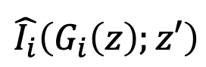
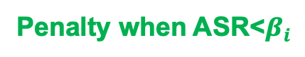
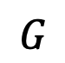
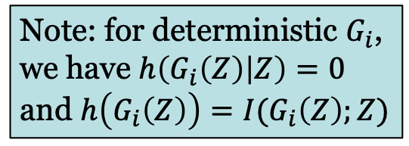
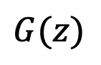
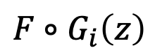
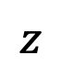
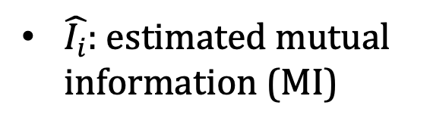
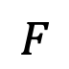
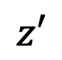
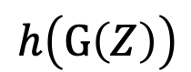
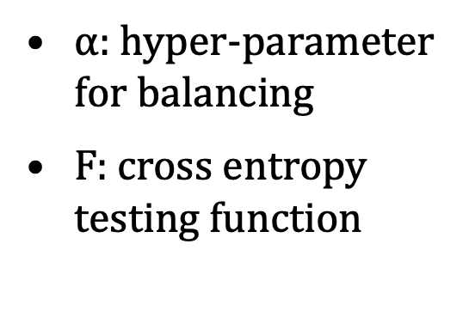
Method: implementation
Loss function trainable by SGD
$$L=−α\hat{I_{i}}\left(G_{i}\left(z\right);z′\right)+\max\left(0,β_{i}−F∘G_{i}\left(z\right)\right)$$
Estimated MI
Estimated ASR
Entropy maximization
Penalty when ASR<$β_{i}$
$\hat{I_{i}}$: estimated mutual information (MI)
$$F$$
Note: for deterministic $G_{i}$, we have $h\left(G_{i}\left(Z\right) | Z\right)=0$ and $h\left(G_{i}\left(Z\right)\right)=I(G_{i}\left(Z\right);Z)$
$$G(z)$$
$$F∘G_{i}\left(z\right)$$
$$G$$
$α$: hyper-parameter for balancing
F: cross entropy testing function
$$h\left(G\left(Z\right)\right)$$
$$z$$
$$z′$$
$$\hat{I_{i}}\left(G_{i}\left(z\right);z′\right)$$

Slide 17
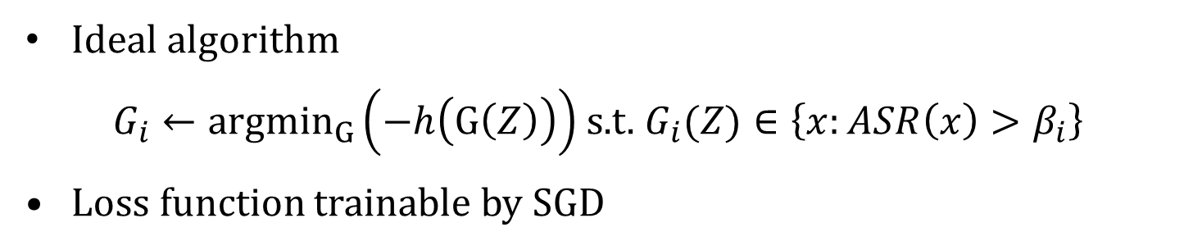
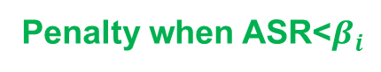
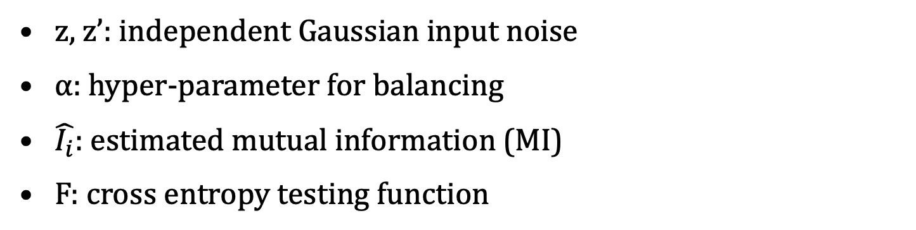
Method: implementation
Ideal algorithm
$G_{i}←{argmin}_{G}\left(−h\left(G\left(Z\right)\right)\right)$s.t. $G_{i}(Z)∈\left\{x:ASR\left(x\right)>β_{i}\right\}$
Loss function trainable by SGD
$$L=−α\hat{I_{i}}\left(G_{i}\left(z\right);z′\right)+\max\left(0,β_{i}−F∘G_{i}\left(z\right)\right)$$
Estimated MI
Estimated ASR
Entropy maximization
Penalty when ASR<$β_{i}$
z, z’: independent Gaussian input noise
$α$: hyper-parameter for balancing
$\hat{I_{i}}$: estimated mutual information (MI)
F: cross entropy testing function

Slide 18
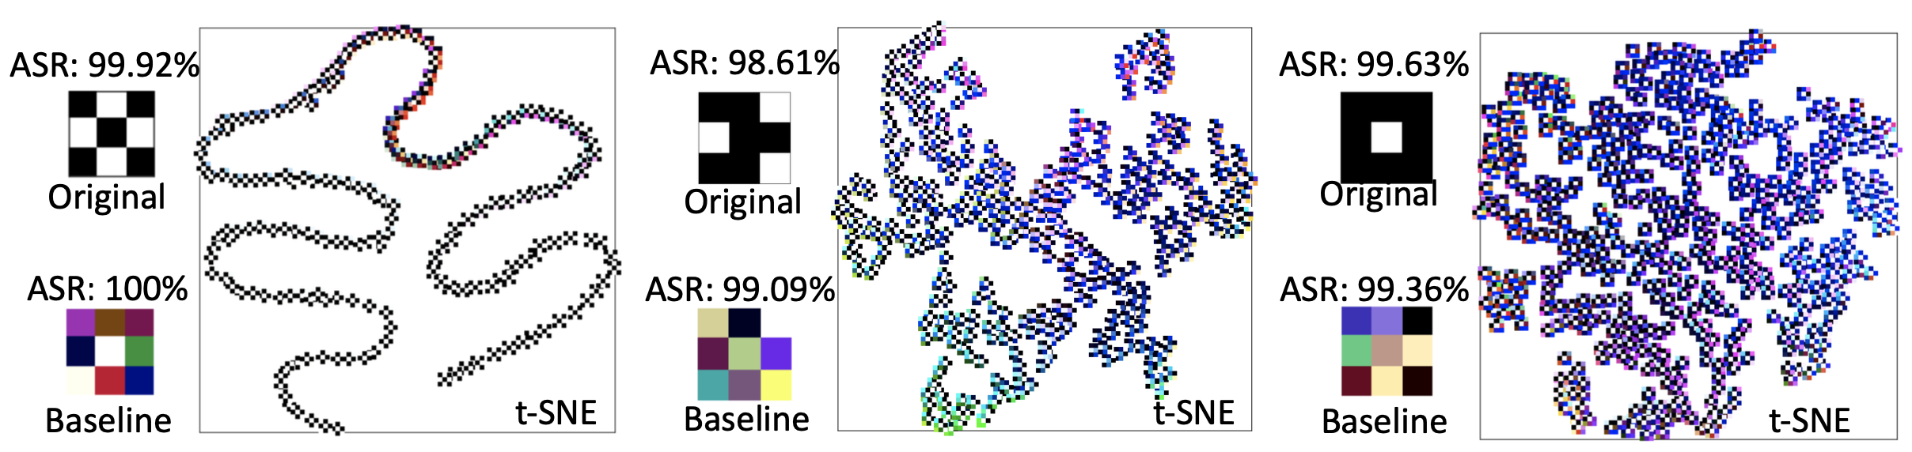
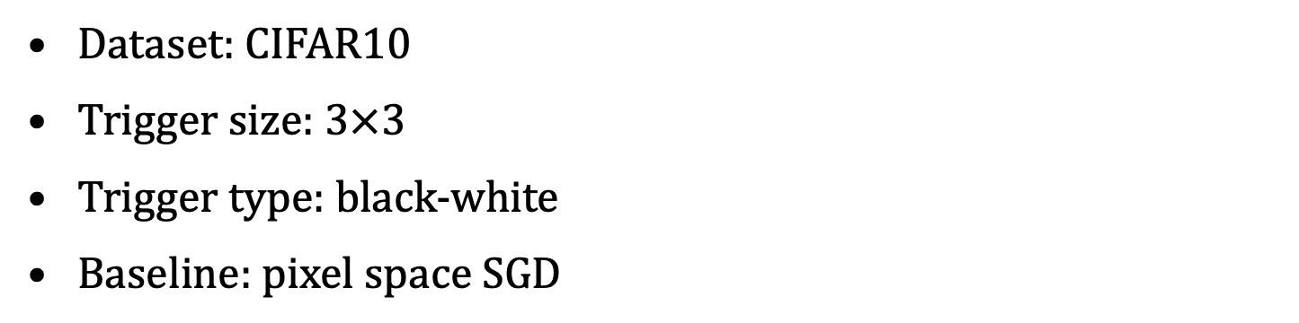
Evaluation: trigger visualization
Dataset: CIFAR10
Trigger size: 3$×$3
Trigger type: black-white
Baseline: pixel space SGD

Slide 19
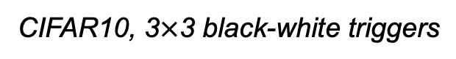
Evaluation: backdoor defense
Retrain the backdoored model with reversed trigger distribution robustly decreases the ASR after defense
Baseline: retrain with a single reversed trigger (pixel space SGD)
CIFAR10, 3$×$3 black-white triggers

Slide 20
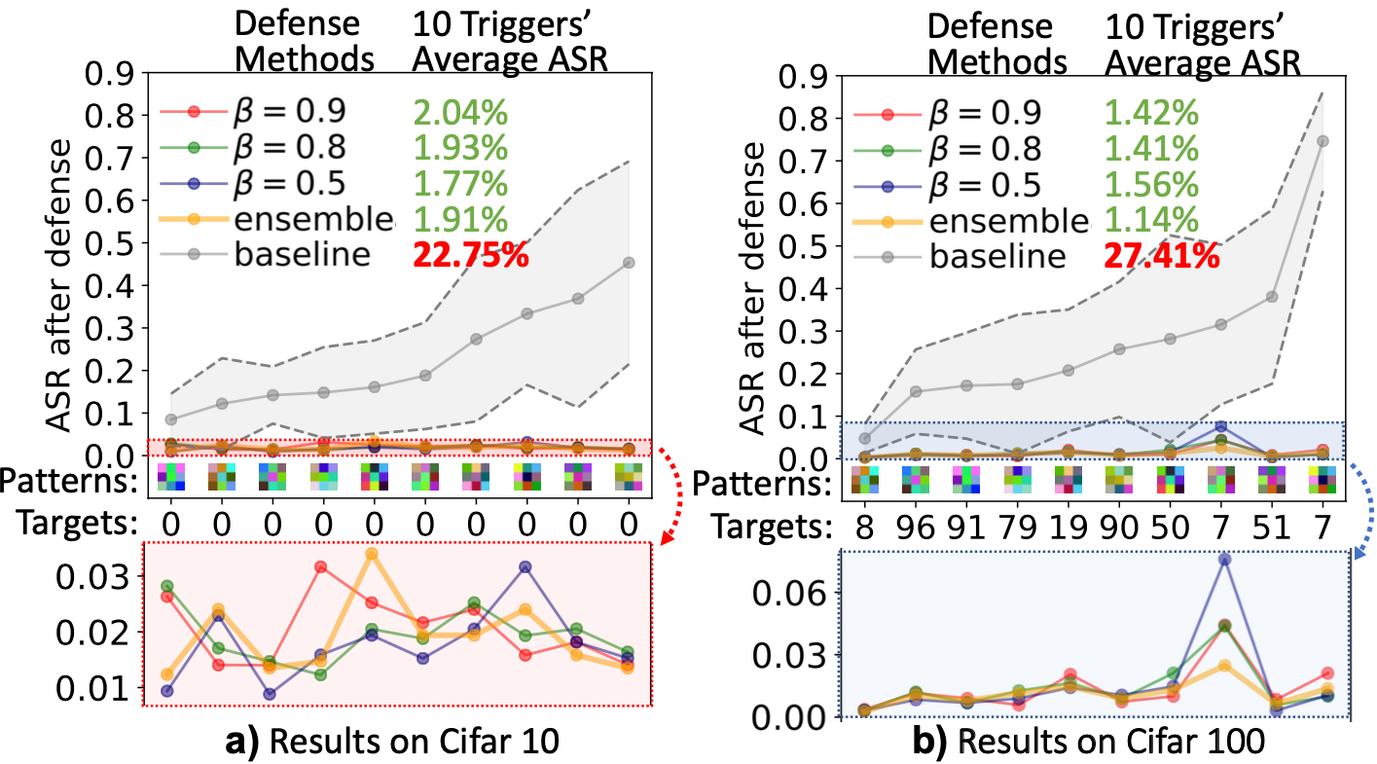
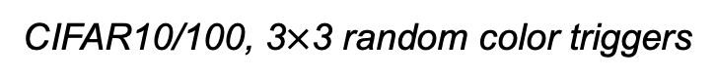
Evaluation: backdoor defense
Retrain the backdoored model with reversed trigger distribution robustly decreases the ASR after defense
CIFAR10/100, 3$×$3 random color triggers

Slide 21
More challenge in realistic defense
CSAW’19 HackML competition background
Holds by OSIRIS Lab and the Center for Cyber Security at NYU Tandon.
Face recognition dataset with 1284 classes, and 10 pics per person.
Challenges:
Limited number of pictures per class with “naturally exist backdoors”.
Trigger with arbitrary shape.
Non-uniform backdoor location (e.g. fixed location).

Slide 22
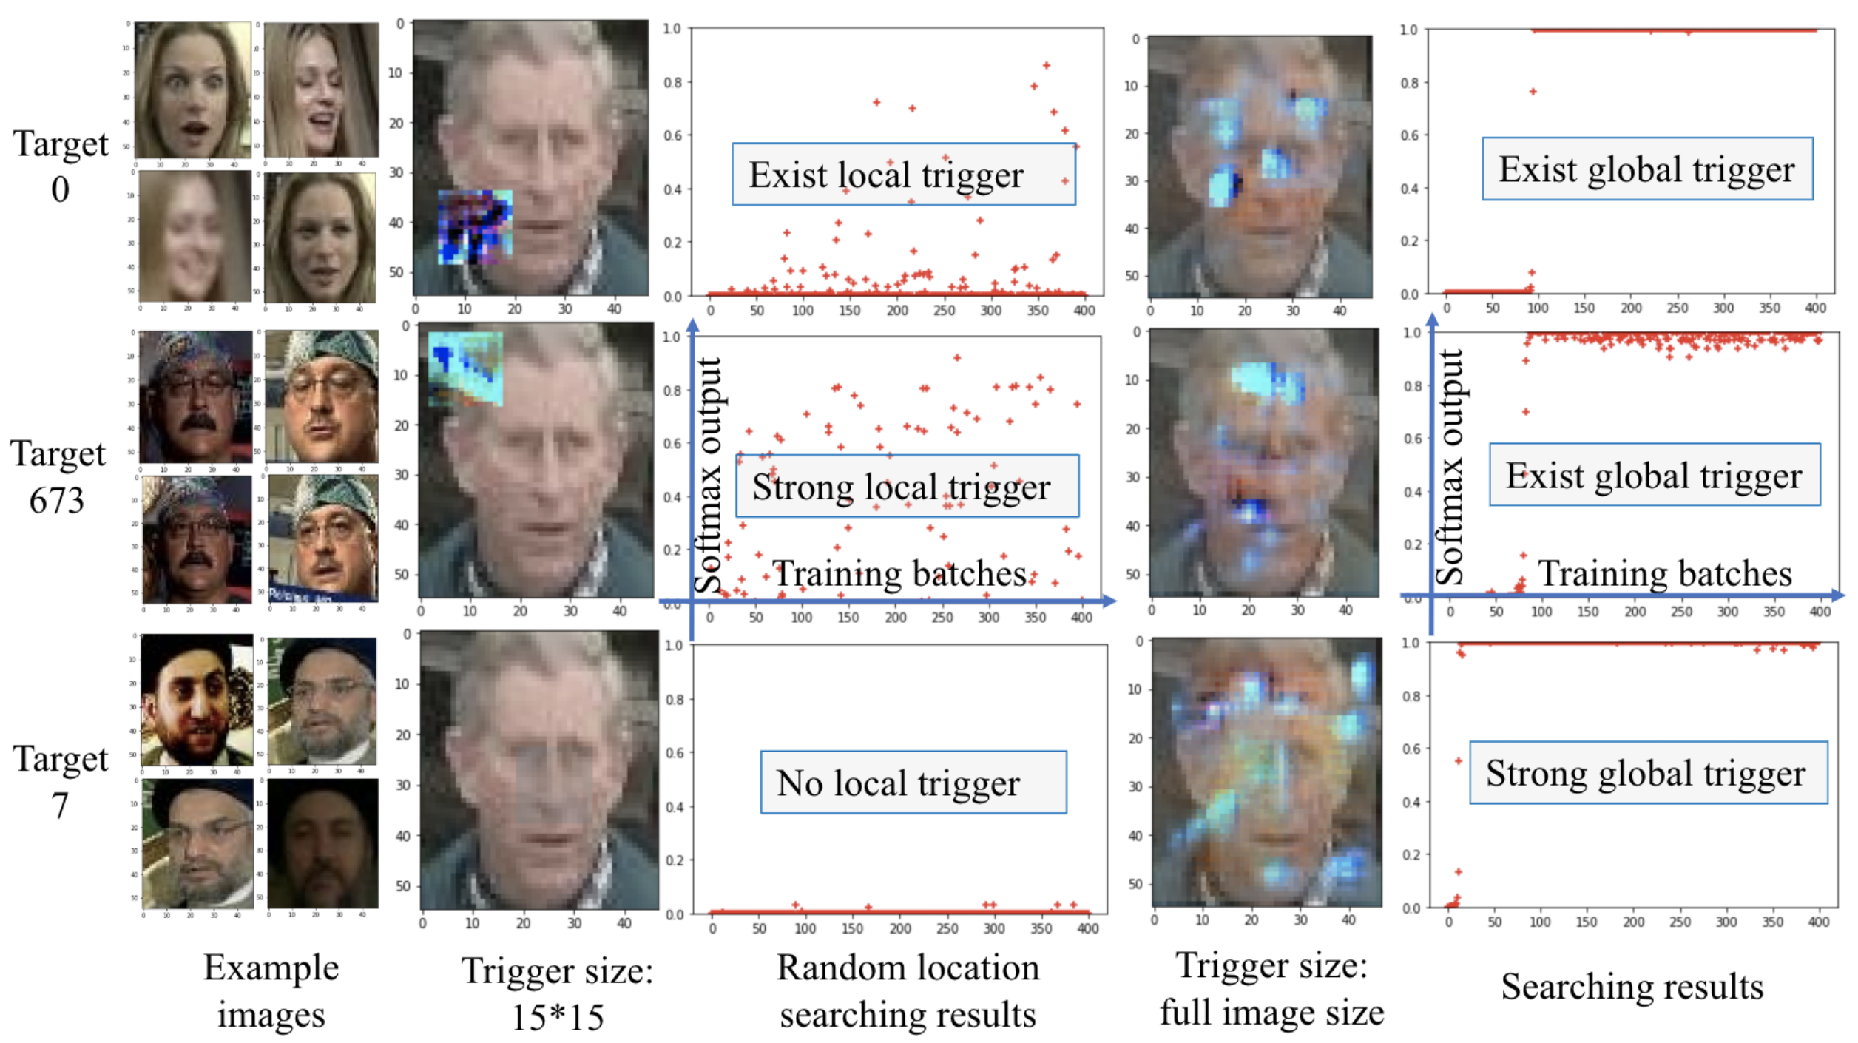
Challenge 1: Naturally exist backdoors
Consider this example:
All 10 pics for this person all wearing a distinguishable hat (or bandana)?
After training, NN builds a strong connection between this hat and this person.
Who wear this hat, who is this guy
We name this as:
Naturally exist backdoors

Slide 23
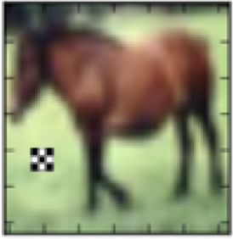

Challenge 2: Trigger with arbitrary shape
Before, we assumed we know the size of a trigger is a 3*3 square. But in realistic backdoor defense, an attacker can design a trigger whatever they like.
We can solve it by adding a transparency channel
Idealize defense
Realistic defense

Slide 24

Challenge 3: Trigger with location fixed
A backdoor trigger with location fixed is no longer global effective. Without any restriction, we may simply find the true facial features of each class.
But where and what size should we set?
No restriction
With restriction

Slide 25
Our solution
To address the above challenges, we proposed three techniques.
Naturally exist backdoors
Repair them with backdoors together
Trigger with arbitrary shape
Add a transparency channel into our searching space
Trigger with location fixed
Moving window detection, with a heat map generated.

Slide 26



Trigger with arbitrary shape
$$\frac{∂ output}{∂ α}$$
Gradient Backpropagate
$$\frac{∂ output}{∂ trigger}$$
Can be solved by adding a transparency
$$Pixel_{after}=\left(1−α\right)·Pixel_{before}+α·trigger$$
The transparency is also differentiable
$$\frac{∂ Pixel_{after}}{∂ α}=−Pixel_{before}+trigger$$
By simply apply the reverse engineering method, we can find a valid trigger.

Slide 27

Experimental results: Step1
Class 0: true backdoor
Class 673: naturally exist backdoor
Both the true backdoor and several strong naturally exist backdoors will be detected together.
We use a 15*15 pixel search window with random location at each round.
Notes:
Insert a initial trigger at a random location, through reverse engineering to find better trigger patterns. By evaluating the average output on the targeting class, we can find the classes that may have been attacked.

Slide 28

Experimental results: Step2.
Generate the heat map through moving window detection.
Reverse engineer the trigger pattern on all locations, and accumulate their strength on the map.
Notes:
Apply a moving window detection for these classes to obtain a heat map of sensitive position.

Slide 29

Experimental results: Step3
Use the heat map as a size indicator to search the complete trigger pattern on it.
Notes:
Reverse engineering with the position and size got from the heat map to get a complete trigger.

Slide 30
Future works
+
Object detection
Generative distribution modeling
Defense complex backdoor triggers with large size and random shape.
Provide a new aspect towards understanding what a neural network truly learnt.

